Slide 1

Design & Analysis of Algorithm
CS-503
Computer Science
Lecture 14
Spanning Tree (Kruskal’s Algorithm)
BY: Bushra Saif

Slide 2
Graph VS Tree
A data structure is a way of organizing data in a systematic way. There are mainly two types of data structures as linear data structures and nonlinear data structures. And, the two common nonlinear data structures are tree and graph.
A tree is a data structure that simulates a hierarchical tree structure, with a root value and subtrees of children with a parent node whereas a graph is a data structure that consists of a group of vertices connected through edges. Thus, this is the fundamental difference between tree and graph.
L1.<number>

Slide 3
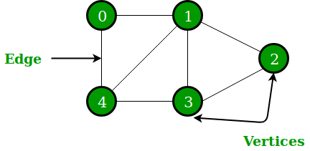
Graph
A graph is a data structure that represents a structure of a set of objects that connects some pairs of objects by links. Usually, graphs help to represent networks.
A graph is collection of two finite non-empty sets Vertex and Edge. Vertices are nothing but the nodes in the graph.
Two adjacent vertices are joined by edges.
Any graph is denoted as G = {V, E}.
L1.<number>

Slide 4
Tree
A tree is a data structure that arranges the data in a hierarchy. A node is a data item in the tree. The major node is the root, and the other nodes are its children nodes. All these other nodes are arranged into the non-empty sets where each one of them is a subtree.
A tree is a finite set of one or more nodes such that,
There is a specially designated node called root.
The remaining nodes are partitioned into n>=0 disjoint sets T₁, T₂, T₃, …, T_{n}
where T1, T2, T3, …, Tn is called the subtrees of the root.
A tree is a data structure that arranges the data in a hierarchy. A node is a data item in the tree. The major node is the root, and the other nodes are its children nodes. All these other nodes are arranged into the non-empty sets where each one of them is a subtree.
A tree is a finite set of one or more nodes such that,
There is a specially designated node called root.
The remaining nodes are partitioned into n>=0 disjoint sets T₁, T₂, T₃, …, T_{n}
where T1, T2, T3, …, Tn is called the subtrees of the root.
L1.<number>

Slide 5
No. | Graph | Tree
1 | Graph is a non-linear data structure. | Tree is a non-linear data structure.
2 | It is a collection of vertices/nodes and edges. | It is a collection of root node and sub trees.
3 | Each node can have any number of edges. | General trees consist of the nodes having any number of child nodes. But in case of binary trees every node can have at the most two child nodes.
4 | More than one path allowed. | Only one path allow between nodes.
5 | A cycle/loop can be formed. | There will not be any cycle.
6 | For finding shortest path in networking graph is used. | Decision tree, binary search tree etc.
L1.<number>

Slide 6
Spanning Tree
A spanning tree is a subset of Graph G, which has all the vertices covered with minimum possible number of edges. Hence, a spanning tree does not have cycles and it cannot be disconnected.
By this definition, we can draw a conclusion that every connected and undirected Graph G has at least one spanning tree. A disconnected graph does not have any spanning tree, as it cannot be spanned to all its vertices.
S ⊆ G
S (V’, E’)
V’ = V
E’ = V-1
Disconnected graphs do not have spanning tree.
L1.<number>

Slide 7
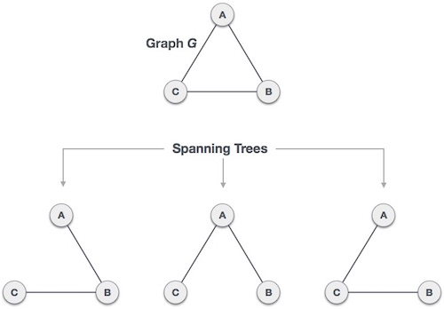
Spanning Tree
We found three spanning trees off one complete graph. A complete undirected graph can have maximum n^{n-2} number of spanning trees, where n is the number of nodes. In the above addressed example, n is 3, hence 3³⁻² = 3 spanning trees are possible.
L1.<number>

Slide 8
Properties of ST
We now understand that one graph can have more than one spanning tree. Following are a few properties of the spanning tree connected to graph G,
A connected graph G can have more than one spanning tree.
All possible spanning trees of graph G, have the same number of edges and vertices.
The spanning tree does not have any cycle (loops).
A complete graph can have maximum nn-2 number of spanning trees.
Removing one edge from the spanning tree will make the graph disconnected, i.e. the spanning tree is minimally connected.
Adding one edge to the spanning tree will create a circuit or loop, i.e. the spanning tree is maximally acyclic.
L1.<number>

Slide 9
Applications of ST
Spanning tree is basically used to find a minimum path to connect all nodes in a graph. Common application of spanning trees are,
Civil Network Planning
Computer Network Routing Protocol
Cluster Analysis
Example: Let us understand this through a small example. Consider, city network as a huge graph and now plans to deploy telephone lines in such a way that in minimum lines we can connect to all city nodes. This is where the spanning tree comes into action.
L1.<number>

Slide 10
Minimum spanning tree
In a weighted graph, a minimum spanning tree is a spanning tree that has minimum weight than all other spanning trees of the same graph. In real-world situations, this weight can be measured as distance, congestion, traffic load or any arbitrary value denoted to the edges.
A minimum spanning tree (MST) or minimum weight spanning tree for a weighted, connected, undirected graph is a spanning tree with a weight less than or equal to the weight of every other spanning tree in a graph
A minimum spanning tree has (V – 1) edges where V is the number of vertices in the given graph.
Given connected graph G with positive edge weights, find a min weight set of edges that connects all of the vertices.
L1.<number>

Slide 11
Why to use greedy method
Consider the following weighted graph, and solve how much trees we can extracted from it and who will give minimum cost to us?
Without all technique we have to check all possible tree s that is time consuming process.
We will learn about two most important minimum spanning tree algorithms here,
  Kruskal's Algorithm
  Prim's Algorithm
1
5
2
4
2
3
3
4
6
L1.<number>

Slide 12
Kruskal’s SPT Concept
Kruskal's algorithm to find the minimum cost spanning tree uses the greedy approach.
This algorithm treats the graph as a forest and every node it has as an individual tree.
A tree connects to another only and only if, it has the least cost among all available options and does not violate MST properties.
L1.<number>

Slide 13
Algorithm steps
Remove all the parallel edges and loops.
Sort the graph edges with respect to their weights.
Start adding edges to the MST from the edge with the smallest weight until the edge of the largest weight.
Only add edges which doesn't form a cycle , edges which connect only disconnected components.
Repeat step 4 until there are (V-1) edges in the spanning tree.
L1.<number>

Slide 14
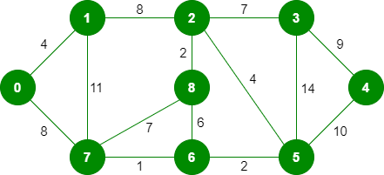
Example
Generate minimum cost spanning tree for the following graph using kurskal’s algorithm.
L1.<number>

Slide 15
Example
Remove all loops and parallel edges from the given graph. In case of parallel edges, keep the one which has the least cost associated and remove all others.
Sort graph edges according to their weight
The step is to create a set of edges and weight, and arrange them in an ascending order of weightage (cost).
The graph contains 9 vertices and 14 edges. So, the minimum spanning tree formed will be having (9 – 1) = 8 edges.
L1.<number>

Slide 16
Weight | Source Node | Destination Node
1 | 7 | 6
2 | 8 | 2
2 | 6 | 5
4 | 0 | 1
4 | 2 | 5
6 | 8 | 6
7 | 2 | 3
7 | 7 | 8
8 | 0 | 7
8 | 1 | 2
9 | 3 | 4
10 | 5 | 4
11 | 1 | 7
14 | 3 | 5
L1.<number>

Slide 17

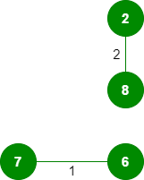
Example
Now pick all edges one by one from the sorted list of edges.
Pick edge 7-6: No cycle is formed, include it.
Pick edge 8-2: No cycle is formed, include it.
L1.<number>

Slide 18
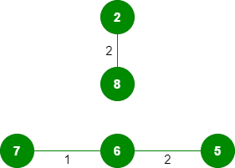
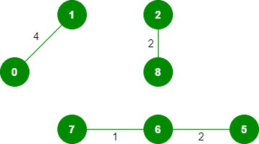
Example
3. Pick edge 6-5: No cycle is formed, include it.
4. Pick edge 0-1: No cycle is formed, include it.

Slide 19

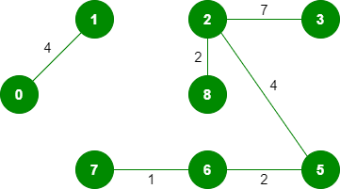
Example
5. Pick edge 2-5: No cycle is formed, include it.
6. Pick edge 8-6: Since including this edge results in the cycle, discard it.
7. Pick edge 2-3: No cycle is formed, include it.

Slide 20
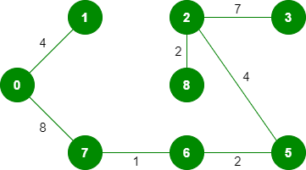
Example
8. Pick edge 7-8: Since including this edge results in the cycle, discard it.
9. Pick edge 0-7: No cycle is formed, include it.
10. Pick edge 1-2: Since including this edge results in the cycle, discard it.
11. Pick edge 3-4: No cycle is formed, include it.

Slide 21
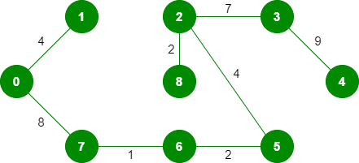
Example
Since the number of edges included equals (V – 1), the algorithm will terminate here.

Slide 22
Complexity
In Kruskal’s algorithm, Sorting of edges takes O(ELogE) time. After sorting, we iterate through all edges and apply the find-union algorithm. The find and union operations can take at most O(LogV) time. So overall complexity is O(ELogE + ELogV) time. The value of E can be at most O(V2), so O(LogV) is O(LogE) the same.
The most time consuming operation is sorting because the total complexity of the Disjoint-Set operations will be O (ElogV), which is the overall Time Complexity of the algorithm.

